Slide 1
EC Sequences — Demo GUI (Keithley)
Work Summary
Until 01/07/2025
Yichao Wang

Slide 2
Userguide
This guide explains how to use the demo GUI that generates voltage sequences, streams them to a Keithley source measure unit (SMU), and plots current live and post-run. No math/algorithms are changed from your original sequence builder—this GUI only wires things together.

Slide 3
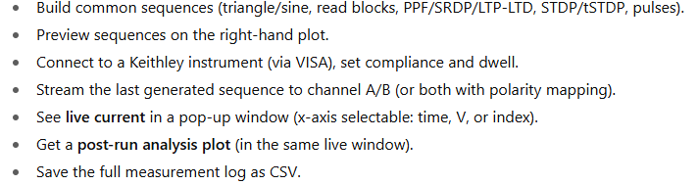
What you can do with this app

Slide 4
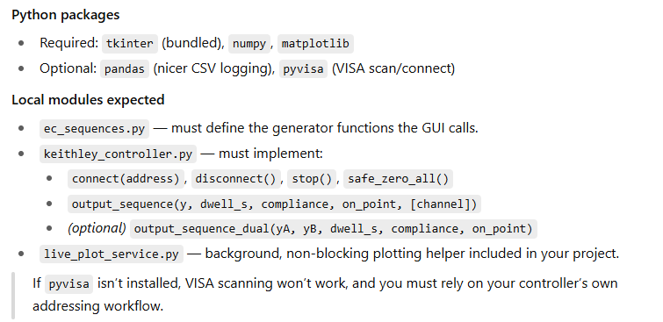
Requirements (Softerware)

Slide 5
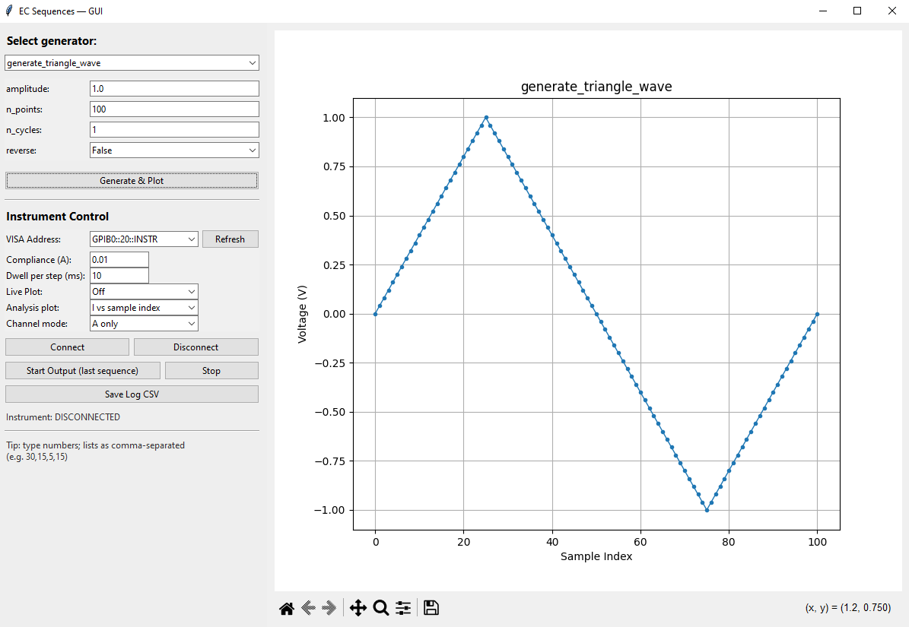
Overall GUI Layout

Slide 6
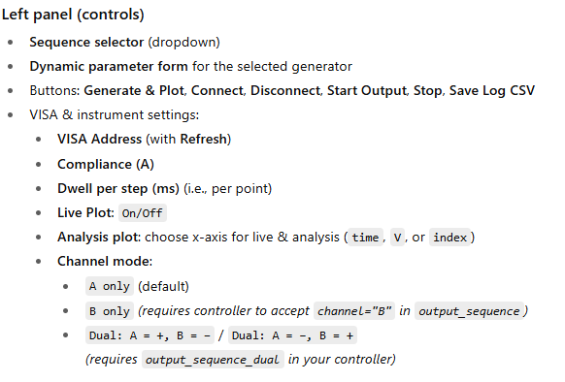
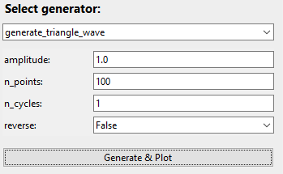
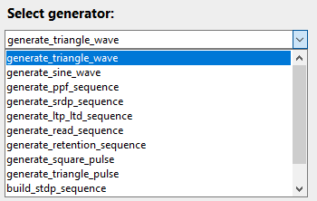
Window layout & controls
The generator supports a variety of voltage sequences.
Note: 0Whenever you adjust the inputs or parameters, remember to click Generate & Plot—otherwise the preview won’t update.

Slide 7
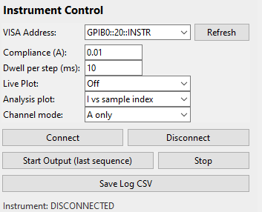
Window layout & controls

Slide 8

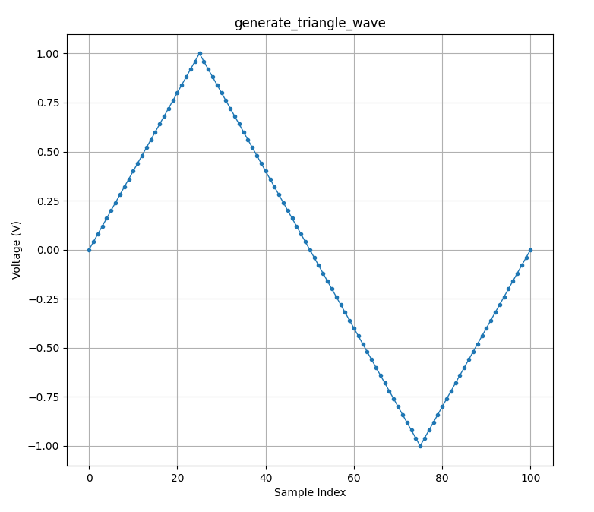
Window layout & controls

Slide 9
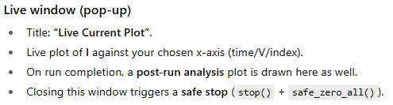
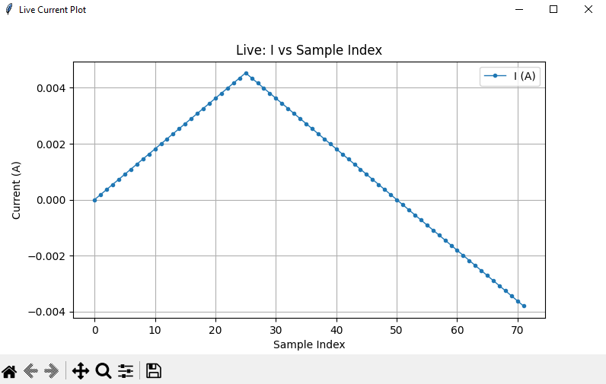
Window layout & controls

Slide 10
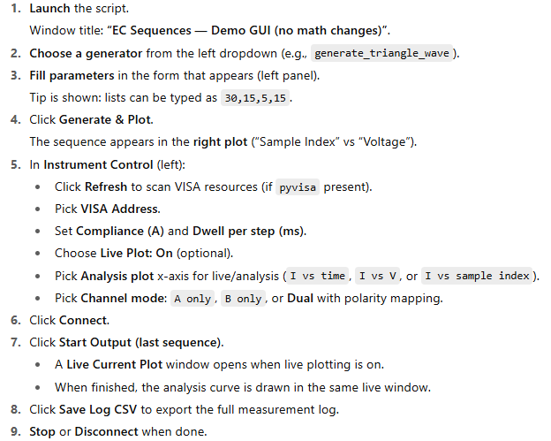
Quick start (happy path)

Slide 11
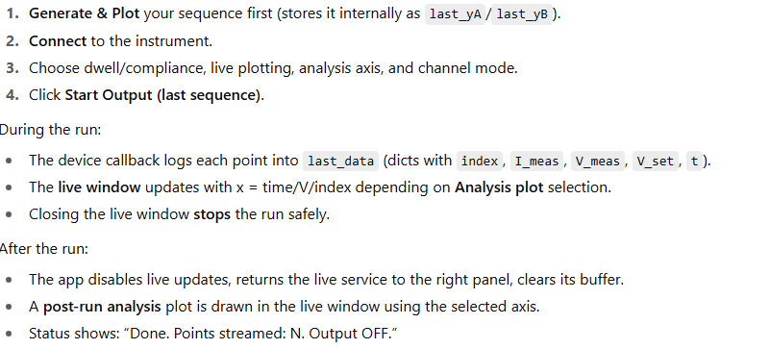
Running a measurement

Slide 12


Saving your data

Slide 13
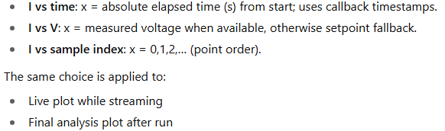
Live & analysis axes

Slide 14
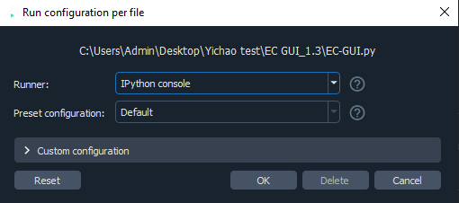
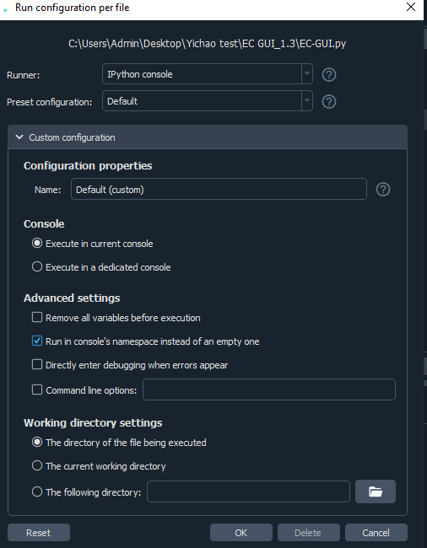
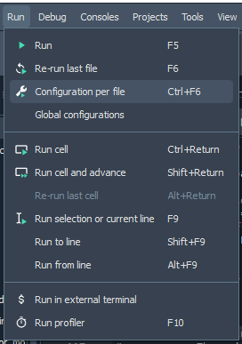
Troubleshooting
There is a common Warning when run this file in a new computer.
The warning in the console is related
to namespace.

